Slide 1
I Don’t Say I Do
A Very Village Wooing

Slide 3
Conversation 1

Slide 4
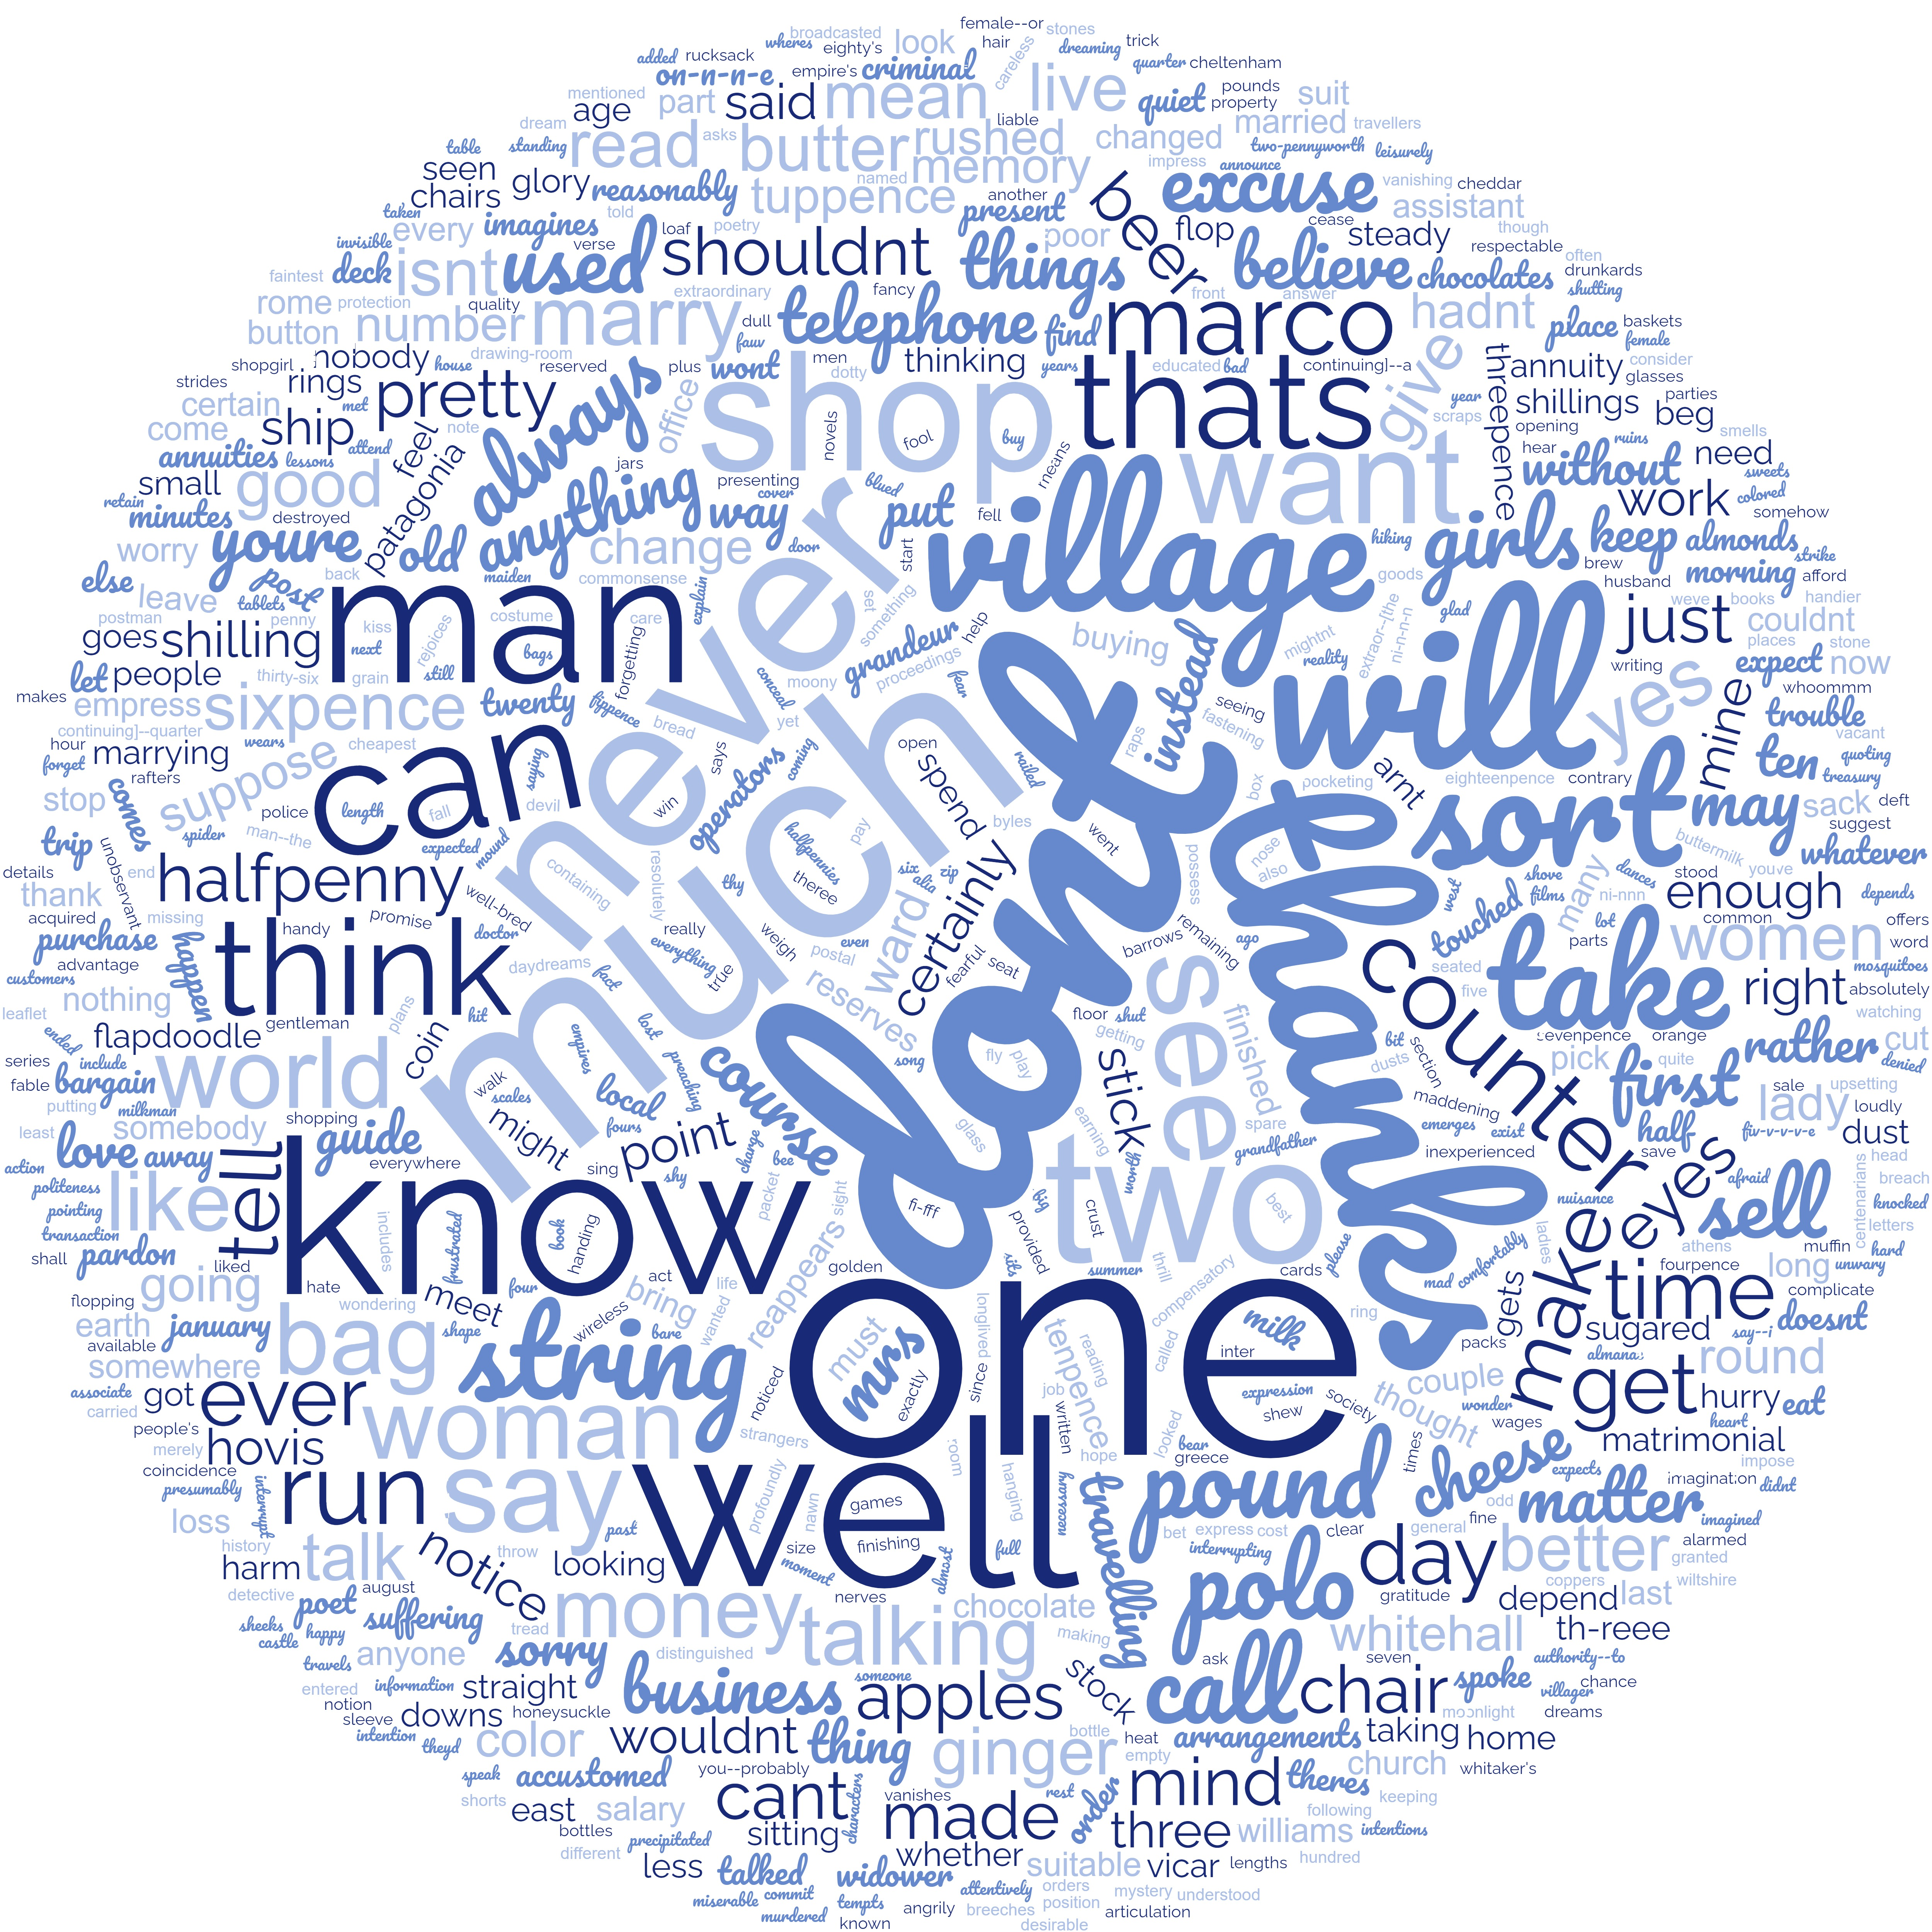
Conversation 2

Slide 5
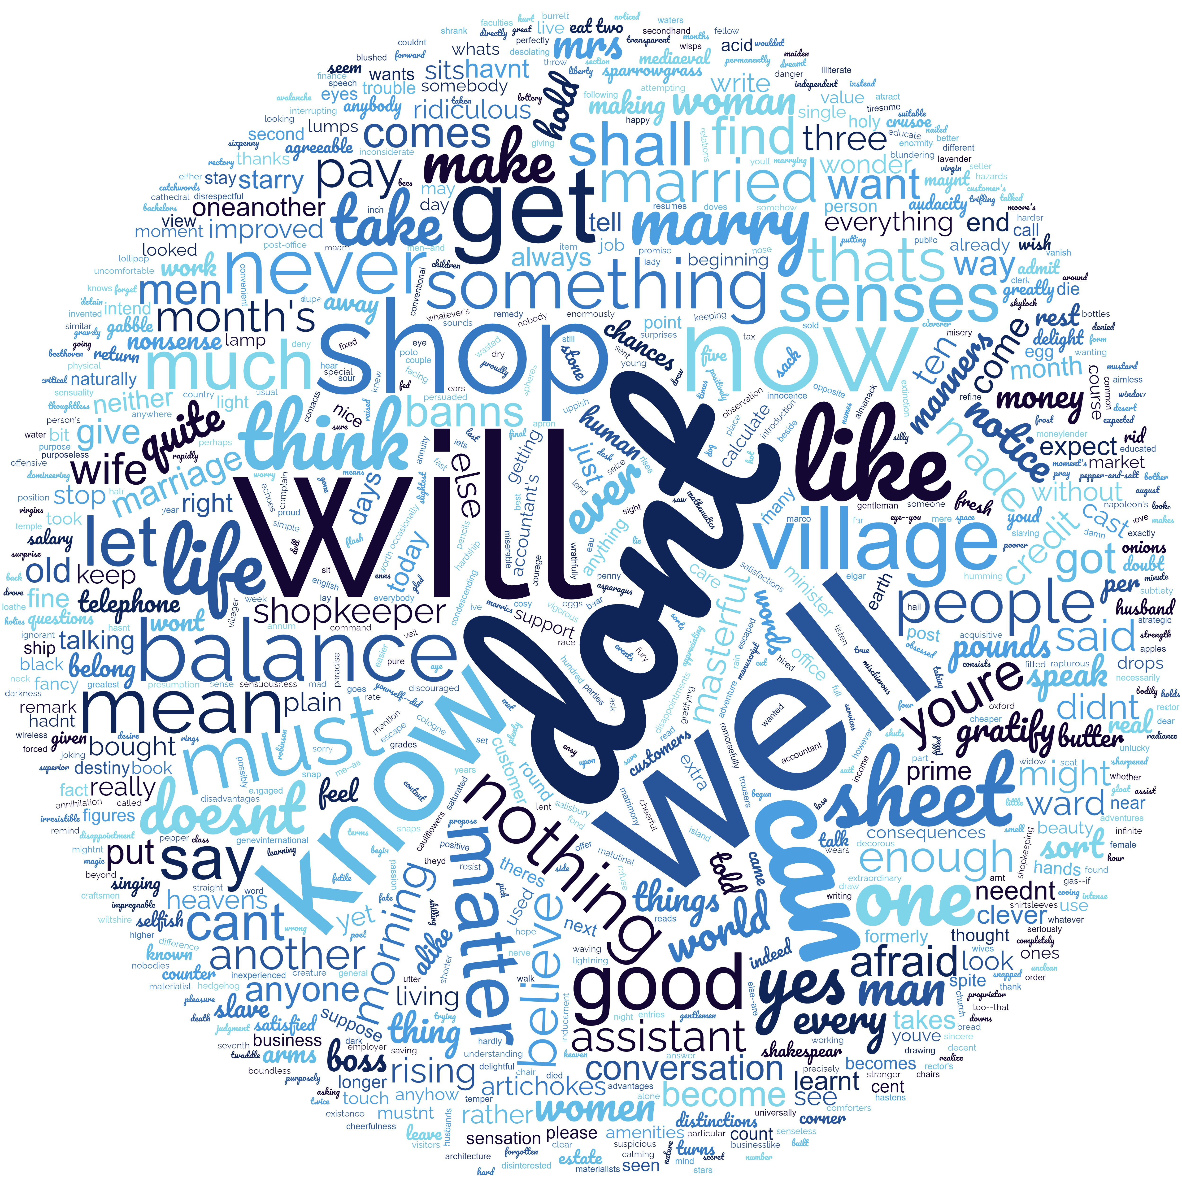
Conversation 3

Slide 6
DON’T !
DON’T ?

Slide 7
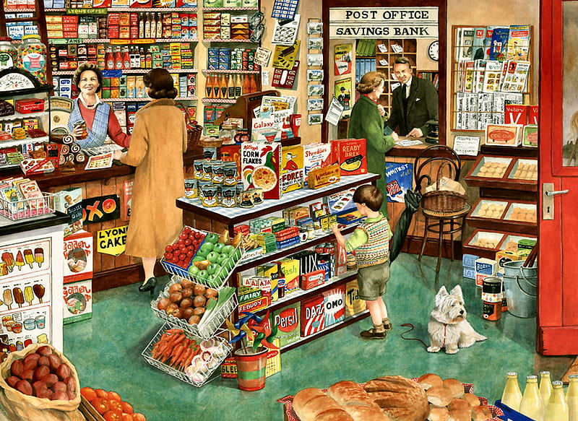

Slide 8
