Slide 1
LOVE AS A POLITICAL CATEGORY IN SHAW’S GETTING MARRIED AND VILLAGE WOOING
needs. 47
needs. 47
Vishnu Patil
Dept. of English,
Deogiri College, Aurangabad
Maharashtra, India
1
Notes:
1

Slide 2
LOVE AS A POLITICAL CATEGORY
Love - Eros, Phileo and Agape
Love - Distinction between ‘Who’ and ‘What’
.
Love – Betrayal, Catastrophe & Violence
Love – Fantasy as a Political Category
Love – Free Will, Law and Society – SHAW HIMSELF
2

Slide 3
The Context
.
3

Slide 4
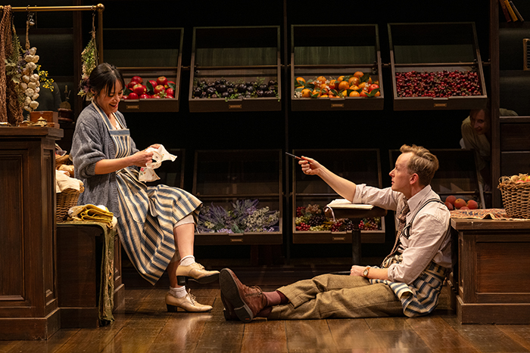
The Context
.
Lesbia & the General
Leo – Reginald & Hotchkiss
A and Z
4

Slide 5
EROS, PHILEO AND AGAPE
EROS – physical, carnal, erotic
PHILEO – friendship, brotherly love
.
AGAPE – charitable love, perfect and unconditional love
5

Slide 6
LOVE AND BEING – BETWEEN WHO & WHAT
WHO – love for absolute singularity
.
WHAT – love for qualities of the person
Death of Love – Not because ‘who’ they are but they are such and such – ‘Fidelity is threatened by the difference between ‘who’ and what’.
LESBIA – The one thing I never could stand is a grout lout of a man smoking all over my house and going to sleep in his chair after dinner, and untidying. Ugh!
LEO – It’s not that I’ve exhausted it; but he will keep on repeating it when I want to read or go to sleep. And Sinjon amuses me. He’s so clever. (Getting Married)
6

Slide 7
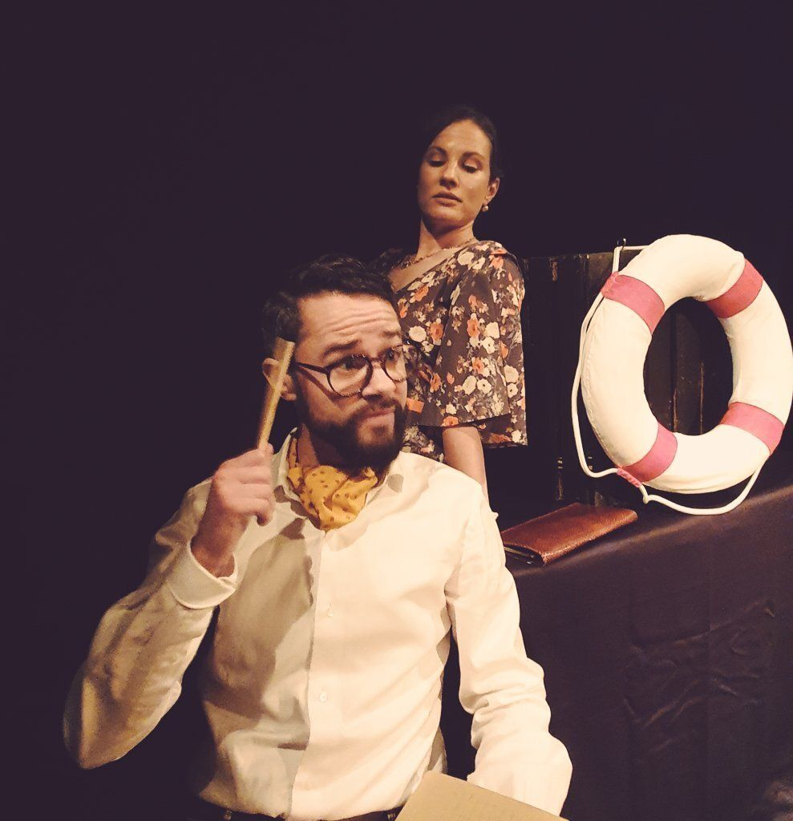
LOVE AND BEING – BETWEEN WHO & WHAT
Love at first sight: what?
Z. Oh. No. You know, if I fell in love with a man I’d never marry him: he could make me so miserable. But there was something about you: I dont exactly know what; but it made me feel that I could do with you in the house; and then I could fall in love with anyone I liked without any fear of making a fool of myself . I suppose it was because you are one of the quiet sort and dont run after women. (Village Wooing)
Collins – I’m that fond of my old Matilda that I never tell her anything at all for fear of hurting her feelings. You see, she’s such an out and-out wife and mother that she’s hardly a responsible human being out of her house, except when she’s marketing. (Getting Married)
7

Slide 8
LOVE – CATASTROPHE & BETRAYAL
LOVE BECOMES CATASTROPHIC WITH ITS ABILITY TO CHANGE THE NORMAL COURSE OF ONES LIFE
GENERAL: I am not cross, only wounded, Lesbia. And when you talk like that, I don’t feel convinced: only feel utterly at loss.
REGINALD: I shouldn’t mind a bit of it if it were for Leo’s sake. But to have to do it to make room for that mushroom-faced serpent..!
8

Slide 9
LOVE – CATASTROPHE & BETRAYAL
BETRAYAL IS THE INTEGRAL PART OF LOVE
REGINALD – The man that would raise his hand to a woman is unworthy the name of Bridgenorth.
LEO: Well, I love both. I should like to marry a lot of men. I should like to have Rejjy for every day, Sinjon for concerts and theatres and going out in the evening, and some great austere saint for about once a year at the end of the season, and dome perfectly blithering idiot of a boy to be quite wicked with.
9

Slide 10
LOVE – CATASTROPHE & BETRAYAL
SHAW’S VIEWS
Oct 12 1896, to Ellen, 676-78: Leading up to a long account of his love affairs, Shaw begins by philosophizing about his relationship with Ellen and women in general: ‘Mind, I am not to be your lover, nor your friend; for a day of reckoning comes for both love and friendship. You would soon feel like the Wandering Jew: you would know that you must get up and move on…
All my love affairs end tragically because the women cant use me. They lie low and let me imagine things about them; but in the end a frightful unhappiness, an unspeakable weariness comes; and the Wandering Jew must go in search of someone who can use him to the utmost of his capacity. Everything real in life is based on need: just so far as you need me I have you tightly in my arms; beyond that I am only a luxury, and, for luxuries, love and hate are the same passion…. And now as to all my love affairs.’
10

Slide 11
LOVE – VIOLENCE - DISASTER
FORMAL VIOLENCE – CONTENT OF VIOLENCE (Graphic)
.
Formal Violence: The manner in which violence can change your reality.
Leo and Reginald – Love is disaster for Reginald – Beating his wife
(REGINALD – The man that would raise his hand to a woman is unworthy the name of Bridgenorth.)
Lesbia and the General – Stays bachelor – Can’t stand sight of wedding cake
11

Slide 12
LOVE – VIOLENCE - SHAW
Nov 7 1896, to Charlotte, who finally said that she missed him, 697:
‘No: you dont love me one little bit. All this is nature, instinct, sex: it proves nothing beyond itself. Don’t fall in love: be your own, not mine or anyone else’s. From the moment that you cant do without me, you’re lost, like Bertha. Never fear: if we want one another we shall find it out. All I know is that you made the autumn very happy, and that I shall always be fond of you for that. About the future I do not concern myself: let us do what lies to our hands & wait for events. My dearest!’
12

Slide 13
LOVE – BETRYAL, CATASTROPE, VIOLENCE
13

Slide 14
LOVE – FANTASY AS POLITICAL CATEGORY
“Function of ideological fantasy in papering over social antagonism or ‘the Real’ by constructing narratives of the loss or theft of jouissance”
14

Slide 15
LOVE – FANTASY AS POLITICAL CATEGORY
15

Slide 16
LOVE – FANTASY AS POLITICAL CATEGORY
He briefly describes Florence, Charlotte, and Janet (676);
‘And then there are others whom I cannot recollect just at present, or whom you dont know anything about. And finally there is Ellen, to whom I vow that I will try hard not to spoil my high regard, my worthy respect, my deep tenderness, by any of those philandering follies which make me so ridiculous, so troublesome, so vulgar with women. I swear it. Only, do as you have hitherto done with so wise an instinct: keep out of my reach’ (677).
16

Slide 17
LOVE – FANTASY AS POLITICAL CATEGORY
March 16 1930, to Lady Rhondda, whose article, “Shaw’s Women,” was being serialized in a journal, 179-80:
Tanner rescues himself from entire sexual futility by this means, marrying a woman whom he has just described (to her mother) as a liar, a bully, and a whore, because he realizes that their union, being so patently willed in spite of his moralizing, must be a job of the Holy Ghost. This leaves him with a much rosier chance of a bearable life than Benedick & Beatrice.
17

Slide 18
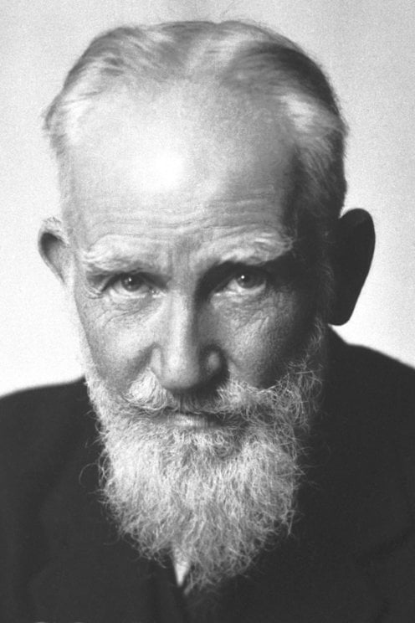
LOVE – FREE WILL, LAW AND SOCIETY
In the Preface to Getting Married Shaw highlights the following issues that offer the logic of his surpassing romanticism:
Sex slavery, Hearth and Home
Limits of Democracy, The Right to Motherhood, Monogamy, Polygamy & Polyandry, Impersonality of Sex,
Divorce a Sacramental Duty, Cost of Divorce
Yet the number of marriages affected more or less in this way (due to holy state of matrimony) must be enormous. When people say that love should be free, their words, taken literally, may be foolish; but they are only expressing inaccurately a very real need for the disentanglement of sexual relations from a mass of exorbitant and irrelevant conditions imposed on them on false pretences to enable needy parents to get their daughter “off their hands” and to keep those who already married effectually enslaved by one another.
18

Slide 19
LOVE – FREE WILL, LAW AND SOCIETY
19

Slide 20
LOVE – SHAW – LIFE FORCE
Nov 23 1918, to Mary Hamilton, 27-28 in Moore: ‘You have been looking for an ideal man without considering that if you found him… And then as to your body being the temple of his children, would any woman ever have children if she reserved her body for dukes or demigods, knowing all the time that it was just an ordinary body like any other woman’s body. But there is a deeper error here than mere self-conceit. What you call your children and his children are neither yours nor his: they are, in the old terms, members of Christ, children of God, and inheritors of the kingdom of Heaven. In modern language they are the children of the Life Force … One must take chances with one’s body if one is to use it at all. I haven’t time to write any more.’
20

Slide 21
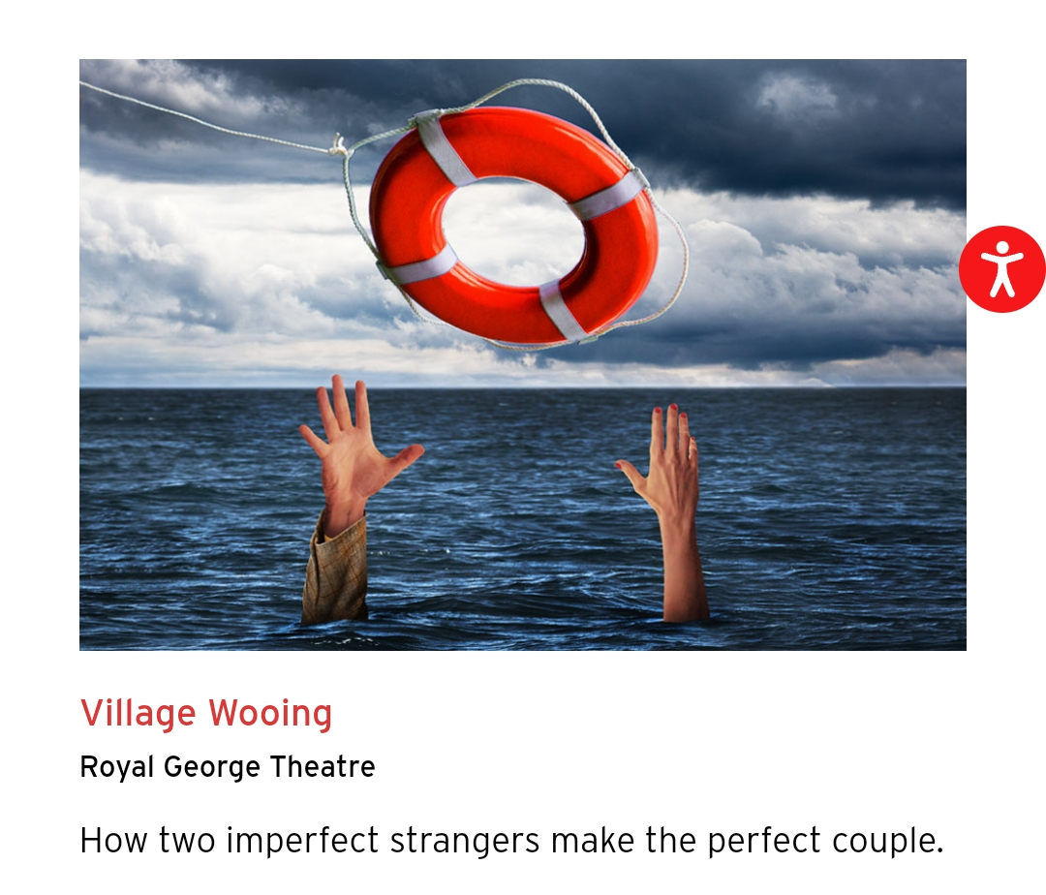
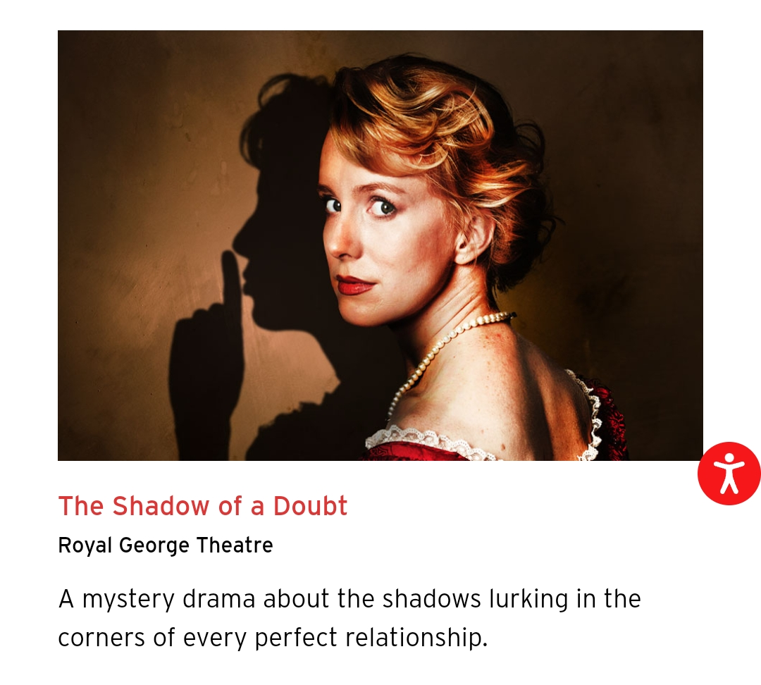
THIS SEASON
21

