Slide 1
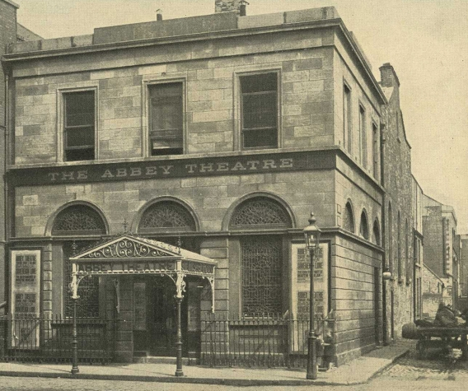
Playboy, Blanco, and Irish Social Realism
Justine Zapin PhD Candidate University College Dublin Justine.Zapin@gmail.com

Slide 2
Social Realism
Often linked to mimesis and verisimilitude, “social realism is about the contemporary world in a direct way, and is seen to reflect, and reflect on, that world, which is, generally speaking, that of its first audience.”
- Raymond Williams

Slide 3
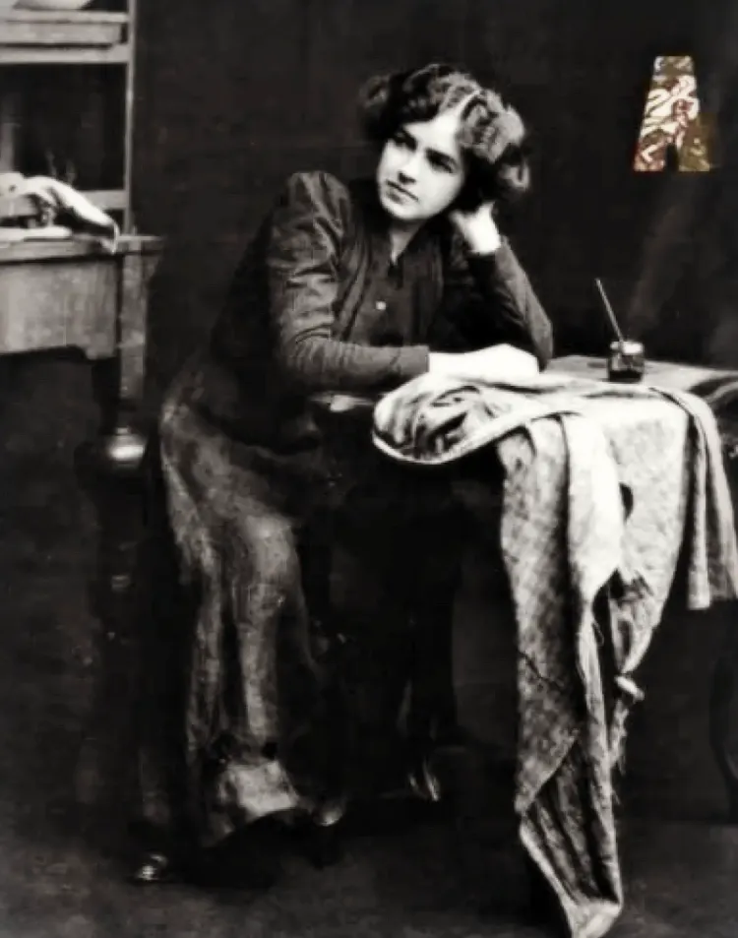
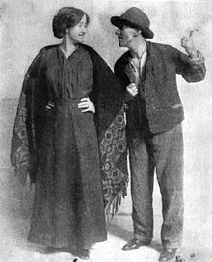
Playboy “was [Synge’s] wrath disguised as a grin.”
-William Fay
Playboy of the Western World
Sara Allgood as Widow Quinn and J. M. Kerrigan as Sean Keogh, 1907
Maire O’Neill (Molly Allgood) as Pegeen Mike, 1907

Slide 4
Playboy of the Western World
Three Act Structure
Gradualist Narrative Delivery
Narrative Frame Provides Frame for Social Criticism
(John Bull / Major Barbara)
Final Act Discussion Between Old Order, New Order, Intervening Stranger
(Keegan, Larry, Broadbent /
Undershaft, Barbara, Cousins)

Slide 5
Playboy of the Western World
Social Critique Showcased in Evolving Contexts
Synge Instructs and Insistent on Inflection/Tone/Pitch
More Present During Rehearsals
Pays Greater Attention to Blocking

Slide 6
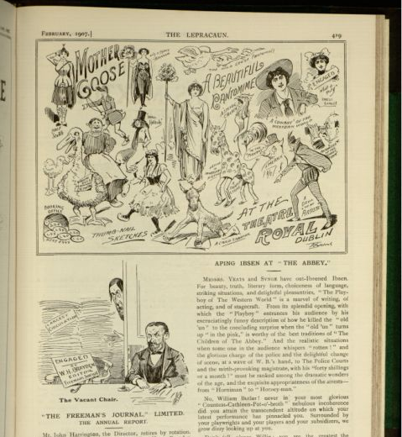
Aping Ibsen at the Abbey
“Messrs. Yeats and Synge have out-Ibsened Ibsen. For beauty, truth, literary form, choiceness of language, striking situations, and delightful pleasantries, “The Playboy of the Western World” is a marvel of writing, acting, and of stagecraft.”
“No William Butler ! never in your most glorious ‘Countess-Cathleen-Pot-o’-broth’ nebulous incoherence did you attain the transcendent attitude on which your latest performance has pinnacled you. Surrounded by your playwrights and your players and your subsidizers, we grow dizzy looking up at you.”
Satirical review of the 1907 Abbey Theatre production of J.M. Synge's The Playboy of the Western World, in The Lepracaun: Cartoon Monthly, vol. II, no. 22 (February 1907).

Slide 7
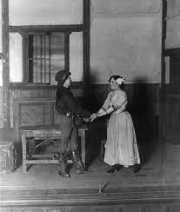
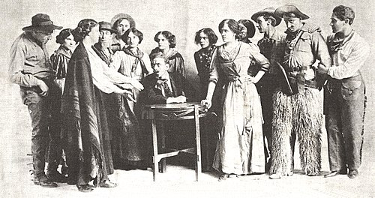
“Shaw is right; it is a sermon. Shaw is a born preacher.”
- James Joyce on Blanco
The Shewing-Up of Blanco Posnet
Fred O’Donovan as Blanco and Sara Allgood as Feemy Evans, 1909
Brinsley MacNamara; ? ; Maire O'Neill; J. A. O'Rourke; Padraic Colum; Una O'Connor; ? ; Sydney J. Morgan; Kathleen Drago; Sara Allgood; Eithne Magee; Udolphus Wright; Fred O'Donovan; J. M. Kerrigan, 1912

Slide 8
First Social Realist One Act
Pithy Dialogue and Storytelling Replace Long Speeches
Single, Indoor Setting Suits Revivalist Aesthetic
Despite the American Frontier Setting Encourages Actors Use “Broad Irish Accents”
Casting
The Shewing-Up of Blanco Posnet

Slide 9
Cast of Characters
Blanco (1909)
Allgood, Sara as Feemy Evans
Barden, Hugh as Jurymen/Boys/Women
Carrick, John as Nestor
Downes, J as Jurymen/Boys/Women
Dunne, J. H. as Jurymen/Boys/Women
Harford, Fred J. as Jurymen/Boys/Women
Kerrigan, J.M. as Strapper Kemp
Magee, Eithne as Emma
Morgan, Sydney J. as Sheriff Kemp
Nairn, Mary as Jessie
O'Brien, J as Jurymen/Boys/Women
O'Doherty, Eileen as Babsy
O'Donovan, Fred as Blanco Posnet
O'Neill, Máire (Molly) as The Woman
O'Rourke, J. A. as Foreman of Jury
O'Sullivan, Sheila as Hannah
Reddy, D(aisy) as Lottie
Sinclair, Arthur as Elder Daniels
Playboy (1907)
Allgood, Sara as Widow Quin
Craig, May as Honor Blake
Fay, Frank J as Shawn Keogh
Fay, William George as Christopher Mahon
Kerrigan, J.M. as Jimmy Farrell
O Dempsey, Brigit as Sara Tansey
O'Neill, Máire (Molly) as Margaret Flaherty (Pegeen Mike)
O'Rourke, J. A. as Philly O'Cullen
O'Sullivan, Alice as Susan Brady
Power, Ambrose as Old Mahon
Sinclair, Arthur as Michael James Flaherty
Wright, Udolphus as Peasant
Young, Harry as Peasant

Slide 10
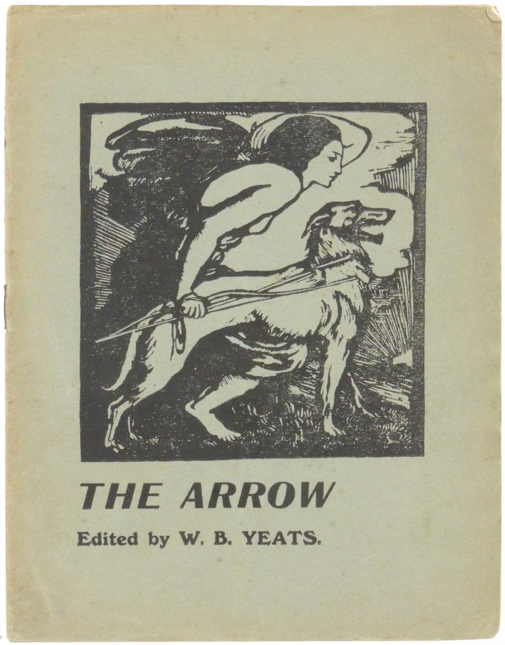
Yeats on Blanco Posnet
“In these bewilderments and shadowy opinions there was nothing to change our conviction (which is also that of the leading weekly paper of the Lord Lieutenant's own party), that so far from containing offence for any sincere and honest mind, Mr. Shaw's play is a high and weighty argument upon the working of the Spirit of God in man’s heart, or to show that it is not a befitting thing for us to set upon our stage the work of an Irishman, who is also the most famous of 'living
dramatists, after that work had been silenced in London by what we believe an unjust decision

Slide 11
Works Consulted
Abbey Theatre. “History”. Abbey Theatre Online. https://www.abbeytheatre.ie/
Frazier, Adrian. Behind the Scenes: Yeats, Horniman, and the Struggle for the Abbey Theatre. Berkeley and Los Angeles, California: University of California Press, 1990. Print.
Gregory, Lady Augusta. Our Irish Theatre: A Chapter of Autobiography. New York and London: G. P. Putnam's Sons, The Knickerbocker Press, 1913. Print.
Gregory, Lady Augusta. Shaw, Lady Gregory and the Abbey: A Correspondence and a Record. eds. Dan H. Laurence and Nicholas Grene. Gerrards Cross: Colin Smythe, 1993. Print.
Matthews, P.J. "Theatre and Activism 1900-1916." The Oxford Handbook of Modern Irish Theatre. eds. Christopher Morash and Nicholas Grene. Oxford Handbooks Online: Oxford University Press, 2016. Print.
Pilkington, Lionel. Theatre and the State in Twentieth-Century Ireland: Cultivating the People. London: Routledge, 2001. Print.
Richards, Shaun. “‘We Were Very Young and We Shrank From Nothing’: Realism and Early Twentieth-Century Irish Drama.” The Oxford Handbook of Modern Irish Theatre. Ed. Nicholas Grene and Christopher Morash. Oxford Handbooks Online: Oxford University Press, 2016. Print.
Ritschel, Nelson O’Ceallaigh. Shaw, Synge, Connolly, and Socialist Provocation. The Florida Bernard Shaw Series. Ed. Dietrich, R. F. Gainesville: University Press of Florida, 2011. Print.

